Slide 1
CS1675 Recitation #2: 9/7/18
These slides are available online:
https://github.com/kc13/CS1675
Agenda for today:
Brief review of PCA/eigenvalue decomposition
Exercises to cover:
Differentiation
Linear algebra basics
Open time for questions about other topics while working on exercises
Quick summary of exercise solutions
Posted online after 2 pm

Slide 2
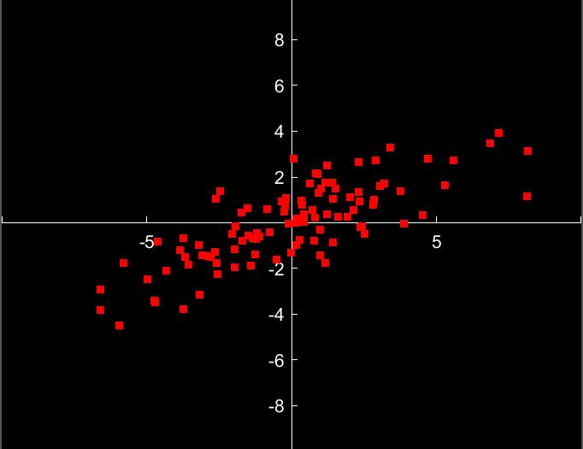
PCA/Eigenvalue decomposition (with some reference to Matlab scripts linked to slide 66 in 2nd slide deck):
Consider the data to the right. How would each point be represented in Matlab?
Random Example:
[6.8723 3.4687]
This is a two dimensional representation. We track each sample’s x and y coordinates.
We can think of each sample as being expressed as a linear combination of the vectors [1,0] and [0,1] (e.g., 6..8723 * [1,0] + 3.4687 * [0,1]). [1,0] and [0,1] are known as basis vectors.

Slide 3
What if we want to use only one dimension?
In other words, we express all data points as a multiple of a single vector. There will be some error (not all points will lie exactly on the line). How do we choose a vector that minimizes that error?
We want to find a vector that captures the direction of maximal variance in the data. An informal guess might put this direction at the dashed green line.

Slide 4
PCA is a quantitative method for finding efficient basis vectors for representation.
Implementation in Matlab (see PCA.m):
Using the matrix M of all points, we first find the covariance matrix:
C = [940.2570 , 414.6830;
414.6830 300.1098]
The diagonal entries of the covariance matrix provide information about the variance along the X and Y dimensions. The off-diagonal entries are influenced by the extent of correlation between X and Y. In other words, it is a summary of the spread of the data.

Slide 5
PCA is a quantitative method for finding efficient basis vectors for representation.
To find the vector that best captures the direction of maximal variance, we want to find the eigenvector associated with the highest eigenvalue for matrix C.
C = [940.2570 , 414.6830;
414.6830 300.1098]

Slide 6
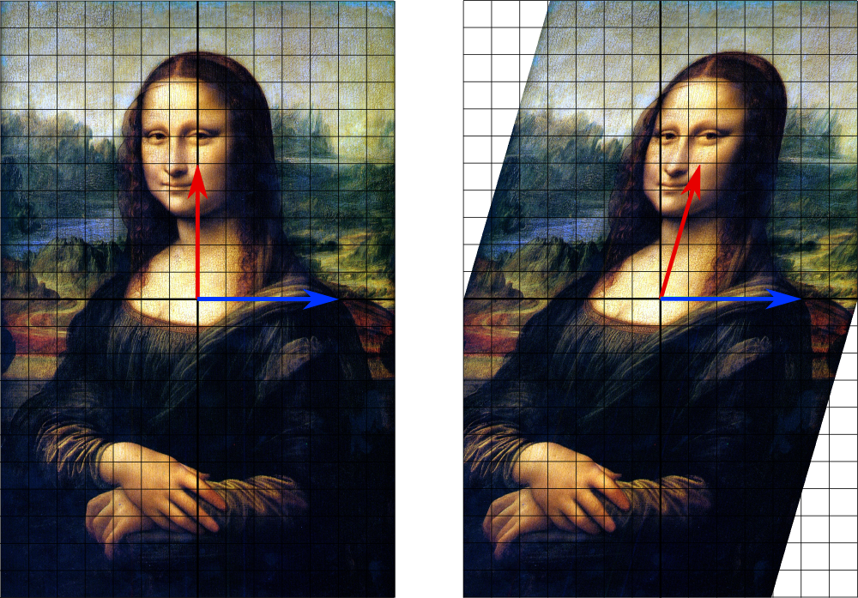
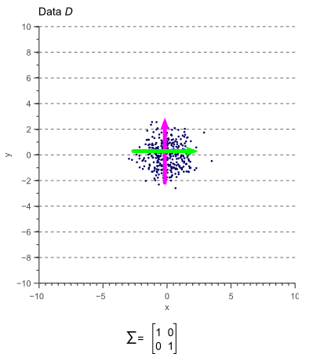
What is are eigenvectors/eigenvalues?
(Side note, not essential material)
We can multiply data by matrices to perform geometric transformations on them. For example, below is shown the result of multiplying an image of the Mona Lisa by a matrix that performs a shear operation:
In a similar way, we can think of the covariance matrix as a set of instructions for spreading out a blob of uncorrelated unit-variance data:
By TreyGreer62 - Image:Mona Lisa-restored.jpg, CC0, https://commons.wikimedia.org/w/index.php?curid=12768508
http://www.visiondummy.com/wp-content/uploads/2014/04/lineartrans.png

Slide 7
What is are eigenvectors/eigenvalues?
The eigenvectors of a matrix are vectors that do not change in orientation when the matrix transformation is applied to them, even though they can be stretched. The degree of stretch is indicated by the corresponding eigenvalue.
In this picture, the blue vector is an eigenvector of the shear transformation, and its eigenvalue is 1 (no stretch).
By TreyGreer62 - Image:Mona Lisa-restored.jpg, CC0, https://commons.wikimedia.org/w/index.php?curid=12768508

Slide 8
What is are eigenvectors/eigenvalues?
Formally: x is an eigenvector of A when Ax = λx, where λ is a scalar, and the eigenvalue of x.
λ can be negative (so
stretches in the
direct opposite direction
are OK)
By TreyGreer62 - Image:Mona Lisa-restored.jpg, CC0, https://commons.wikimedia.org/w/index.php?curid=12768508

Slide 9

Returning to PCA:
C = [940.2570 , 414.6830;
414.6830 300.1098]
To find the top eigenvector/eigenvalue pair in Matlab:
[evec, evalue] = eigs(C, 1); % Compute top eigenvalue
Result:
Evec =
-0.8975
-0.4410
Evalue = 1.1440e+03
Eigenvector = green line

Slide 10
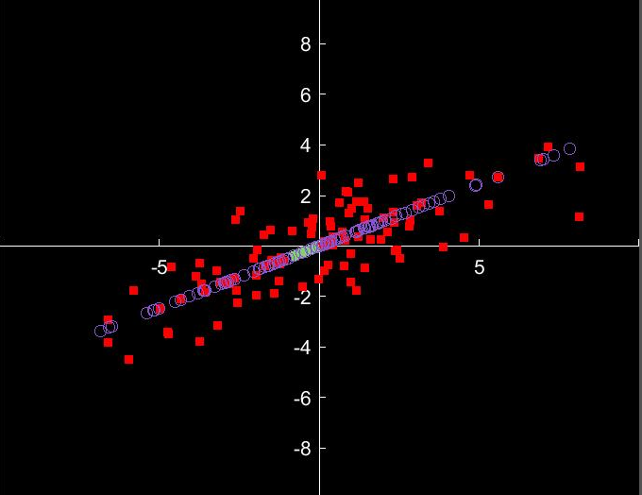
Returning to PCA:
Now that we have the vector that best captures the direction of maximal variance, we can project the datapoints onto this line. Their placement on this line determines their value along this “principal component.”
For datasets with more dimensions, we might choose to make use of a larger number of highly ranked principal components (e.g., 4D down to a 2D space). Matlab can return up to n orthogonal basis vectors for an n-dimensional dataset.

Slide 11
Differentiation and linear algebra basics:
For differentiation problems: See rec2problems.pdf in https://github.com/kc13/CS1675
These are the three problems on the right side of slide 102 in ml_01_intro.pdf (final answers on 103)
The product rule (slide 100) and the chain rule (slide 101) might be especially helpful.
Log -> ln (not log10)
This pdf file also includes a few basic linear algebra questions at the end, if a review would be helpful.

